Slide 1
UAVSAR LITE
Steven daniels
Sprint 2

Slide 2
Sprint OBECTIVE
The goal of this sprint was to:
Design the embedded software
Design radar software
Create test cases for UAVSARLITE embedded software
Create test cases for UAVSARLITE radar software

Slide 3
Octocopter software
STEVEN DANIELS

Slide 4
Octocopter test cases
Define test cases for the following:
Octocopter can be connected to a ground station via a TCP, UDP or serial connection.
Octocopter sends (vendor, software versions, product versions information.
Octocopter sends vehicle telemetry and state information (e.g. battery, GPS, RC connection, flight mode etc.) and set telemetry update rates.
Octocopter performs arm, disarm, kill, takeoff, land, loiter,Waypoint, and return to launch command.
Octocopter flys missions created by ground station
Octocopter receives telemetry data

Slide 5
Software dfd send flight control cmds
Navio2 Flight Control Module
Android Device
Command Navio2 using ArduPilot
Pass commands to QGroundControl
(Android App)
FC commands
FC commands
FC commands

Slide 6
Software dfd receive flight control cmds
Navio2 Flight Control Module
Android Device
ArduPilot
QGroundControl(Android App)
FC commands
FC commands
FC commands

Slide 7
Embedded SOFTWARE
STEVEN DANIELS

Slide 8
Software dfd for i/q data from IWR6843AOP to UAVSARLITE_LINUX app
IWR6843AOP module
Send packet to UAVSARLITE_Linux
(DCA10OO
EVM)
RAW I/Q DATA
Store I/Q data sample using UAVSARLITE_Linux
(Raspberry Pi 4)
RAW I/Q DATA
RAW I/Q DATA
Raspberry Pi 4 GB RAM

Slide 9
Software dfd for IMU Data from ardupilot to UAVSARLITE_LINUX app
ArduPilot
Send MavLink packet to UAVSARLITE_Linux
(Raspberry Pi 3)
Store MavLink data using UAVSARLITE_Linux
(Raspberry Pi 4)
IMU Data
IMU Data
IMU Data
Raspberry Pi 4 GB RAM

Slide 10
Software dfd for i/q data from IWR6843AOP module to UAVSARLITE_Android app
IWR6843AOP module
Android Device
Send packet to UAVSARLITE_Android (Raspberry Pi 4)
Packet deserialization on UAVSARLITE_Android
(Android Device)
Plot radar data with UAVSARLITE_Android
(Android Device)
RAW I/Q DATA
RAW I/Q DATA
RAW I/Q DATA
RAW I/Q DATA

Slide 11
Software dfd for IMU Data from ArduPilot (Navio2) to UAVSARLITE_Android app
ArduPilot
(Navio2)
Android Device
Send IMU data packet to UAVSARLITE_Android (Raspberry Pi 4)
Packet deserialization on UAVSARLITE_Android
(Android Device)
Plot radar data with UAVSARLITE_Android
(Android Device)
IMU Data
IMU Data
IMU Data
IMU Data

Slide 12
Software Embedded Environment
Operating System | UBUNTU SERVER
Programming language | C++
Version Control | Git
IDE | Visual Studio
GitHub | https://github.com/level2fast/UAVSARLITE_APP
Google Drive | https://drive.google.com/drive/folders/1VCX5rsDp7lvDYmyz8F9QWnNmddW9AwOj?usp=sharing

Slide 13
Software drone
Ground Control Station | QGroundControl | http://qgroundcontrol.com/
ArduPilot Host OS | Linux | https://ubuntu.com/download/raspberry-pi-2-3-core
Flight Control Commands protocol | MavLink | mavlink.io/en/about/implementations.html
Drone Testing | SITL | ardupilot.org/dev/docs/sitl-native-on-windows.html

Slide 14
Control UAV
Steps to control UAV:
Assemble Drone
Install QGroundControl on Android Device
Configure Navio2 Flight Control Module to use TCP connection to send data wirelessly to Raspberry Pi 4.

Slide 15
Embedded Software Test cases
RP4_UAVSARLITE_Sender:
Connection with Host PC
Connection with SQLite database
Verify UAVSARLITE data packets sent
RP4_UAVSARLITE_Receiver:
Connection with ArduPilot
Connection with IWR6843AOP
Verify reception of IMU data
Verify reception of RAW I/Q data
Verify synchronization of IMU and RAW I/Q data
QGroundControl:
Octocopter can be connected to a ground station via a TCP, UDP or serial connection.
Octocopter sends (vendor, software versions, product versions information.
Octocopter sends vehicle telemetry and state information (e.g. battery, GPS, RC connection, flight mode etc.) and set telemetry update rates.
Octocopter performs arm, disarm, kill, takeoff, land, loiter,Waypoint, and return to launch command.
Octocopter flys missions created by ground station
Octocopter receives telemetry data

Slide 16
Software embedded resources
Visual studio installation:
https://devblogs.microsoft.com/cppblog/linux-development-with-c-in-visual-studio/
SQLite
https://developer.android.com/training/data-storage/sqlite
https://linoxide.com/linux-how-to/install-use-sqlite-linux/

Slide 17
Send RADAR data to a computer wirelessly
Steps to control UAV:
Load RTOS onto Raspberry Pi 4
https://projects.raspberrypi.org/en/projects/raspberry-pi-setting-up/3
Setup Visual studio development environment.
https://marketplace.visualstudio.com/items?itemName=VisualCppDevLabs.VisualCforLinuxDevelopment
Create c++ app that uses a wireless connection to receive data via TCP.
Create an pc app/android app that uses a wireless connection to send data via TCP for testing.
https://www.programminglogic.com/example-of-client-server-program-in-c-using-sockets-and-tcp/
https://developer.android.com/training/connect-devices-wirelessly
Send data over Wifi to PC or Android app.
https://askubuntu.com/questions/775597/how-to-use-onboard-wifi-on-raspberry-pi-3-with-ubuntu-server-16-04
https://hewlettpackard.github.io/wireless-tools/Tools.html
https://stackoverflow.com/questions/45984345/how-to-turn-on-off-wifi-hotspot-programmatically-in-android-8-0-oreo

Slide 18
Radar SOFTWARE
STEVEN DANIELS

Slide 19
Radar sw design objectives
Define development environment
Define SAR design
Define Radar Parameters
Choose a SAR algorithm to implement
Determine what IWR6843 radar configuration is best for detecting range, Doppler and creating SAR images .
Select corner reflector design for testing radar.
Select SAR operating mode
Create SAR I/Q data flow
Create UAVSARLITE_Data_Processor structural and block diagrams
Create SAR test cases

Slide 20
RADAR development Environment
Operating System | Windows
Programming language | MATLAB
Version Control | Git
IDE | MATLAB
Library | Simulink Support Package for Android Devices https://www.mathworks.com/help/supportpkg/android/index.html?s_tid=CRUX_lftnav

Slide 21
Define sar parameters
An excel spreadsheet will be used to keep track of all SAR parameters. Parameters were separated into 3 categories:
IWR6843AOP Parameters
"Introduction to Airborne Radar" parameters
IWR6843AOP USRR Chirp Configuration Parameters

Slide 22
IWR6843AOP Parameters
IWR6843AOP Parameters
Frequency |  | 60- to 64 | GHz coverage
Wavelength |  | 5 | mm | λ = C/f Where, λ (Lambda) = Wavelength in meters,c = Speed of Light (299,792,458 m/s),f = Frequency
Height of Antenna |  | 10.4 | mm
Length of Antenna |  | 10.4 | mm
Space between Antenna Elements |  | 2.5 | mm
Bandwidth |  | 4 | GHz | 4-GHz continuous bandwidth
Field Of View Azimuth |  | 130 | degrees | 130º azimuth FoV and 130º elevation FoV
Field Of View Elevation |  | 130 | degrees | 130º azimuth FoV and 130º elevation FoV
Azimuth Beamwidth(4Rx, 3Tx in Demo Visualizer) |  | 30 | degrees | https://dev.ti.com/gallery/view/mmwave/mmWave_Demo_Visualizer_IWR6843AOP/ver/1.0.0/
Elevation Beamwidth(4Rx, 3Tx in Demo Visualizer) |  | 30 | degrees | https://dev.ti.com/gallery/view/mmwave/mmWave_Demo_Visualizer_IWR6843AOP/ver/1.0.0/
Azimuth Beamwidth(4Rx, 1Tx in Demo Visualizer) |  | 60 | degrees | https://dev.ti.com/gallery/view/mmwave/mmWave_Demo_Visualizer_IWR6843AOP/ver/1.0.0/
Elevation Beamwidth(4Rx, 1Tx in Demo Visualizer) |  | 60 | degrees | https://dev.ti.com/gallery/view/mmwave/mmWave_Demo_Visualizer_IWR6843AOP/ver/1.0.0/

Slide 23
Introduction to Airborne Radar" parameters
Introduction to Airborne Radar" parameters
2-way 4dB Beamwidth(Uniformally illuminated synthetic array) |  | 0.240385 | radians | wavelength/(2*L), where L = Length of aperture | 13.77302 | degrees
2-way 3dB Beamwidth(Uniformally illuminated synthetic array) |  | 0.211538 | radians | wavelength/(2*L), where L = Length of aperture | 12.12026 | degrees
1-way 3dB Beamwidth(Uniformally illuminated real array) |  | 0.423077 | radians | 0.88(wavelength/L), where L = Length of aperture | 24.24052 | degrees
Null to Null Beamwidth(Uniformally illuminated array) |  | 0.961538 | radians | 2*(wavelength/L), where L = Length of aperture | 55.0921 | degrees
Desired Resolution Cell Size |  |  |  | see "Introduction to Airborne Radar book"
Dimension Azimuth |  | 0.20 | ft | The distance in azimuth of the side of a resolution cell
Dimension Range |  | 0.20 | ft | The distance in range of the side of a resolution cell
Ahievable Resolution Cell Size |  |  |  | see "Introduction to Airborne Radar book"
Dr |  | N/A | ft | 500* t feet where t = compressed pusle width, required bandwidth = 1/t | N/A
Da |  | 61.47541 | mm | (wavelength/2L)*R where L = array length, same units as wavelength | 0.201691 | ft
Max unambiguous range(R) |  | 22500 | mm | This value is the same as USRR Chirp Configuration Parameters max unambiguous range | 73.8189 | ft
Synthetic Array Length(L) |  | 915 | mm | This value was selected to achieve a Da of .2 ft or approx 2 inches | 3.001969 | ft
Da Min(Strip map radar) |  | 5.2 | mm | Length of Real Antenna/2, ultimate resolution for a synthetic array whose beam is positioned at a fixed angle relative to the flight path, as in strip map radars Pg. 415

Slide 24
IWR6843AOP USRR Chirp Configuration Parameters
IWR6843AOP USRR Chirp Configuration Parameters |  |  |  | USRR = Ultra Short Range Radar, take from Texas Instruments document swra553
Max unambiguous range |  | 22.5 | m
Sweep bandwidth |  | 1500 | Mhz
Ramp slope |  | 30 | MHz/us
Inter-Chirp duration |  | 50 | us
Number of chirps |  | 128 | -
Range Resolution |  | 0.1 | m | c/(2*B), where c = speed of light, and B = Sweep bandwidth of FMCW chirp Calculated using matlab
Chirp Duration |  | 50 | us
Max unambiguous relative velocity |  | 35.5 | kmph
Max beat frequency |  | 4.5 | MHz
ADC sampling rate (complex) |  | 5 | Msps
Number samples per chirp |  | 250
Range FFT size |  | 256 | -
Frame time (total) |  | 12.8 | ms
Frame time (active) |  | 6.4 | ms
Radar data memory required |  | 512 | KB | For 1 radar data cube

Slide 25
Radar dfd i/q data
RF Data
Android Device
IWR6843AOP module
MMWAVEIC
BOOST
DCA10OO
EVM
Raspberry
Pi 4
RAW I/Q DATA
RAW I/Q DATA
RAW I/Q DATA
RAW I/Q DATA
RAW I/Q DATA

Slide 26
Corner reflector
A radar corner reflector is used to test the SAR. Radar corner reflectors are designed to reflect the microwave radio waves emitted by radar sets back toward the radar antenna. This causes them to show a strong "return" on radar screens.
To recognize the shapes of objects on the ground such as vehicles, houses, and small buildings a fine resolution is required. As a rule, the required resolution distance is somewhere between 1/5th and 1/20th of the major dimension of the smallest object to be recognized.

Slide 27
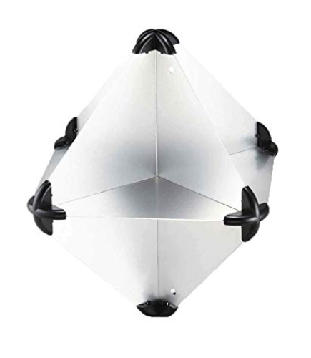
corner reflector
Five Oceans Radar Reflectors, 12" x 12"

Slide 28
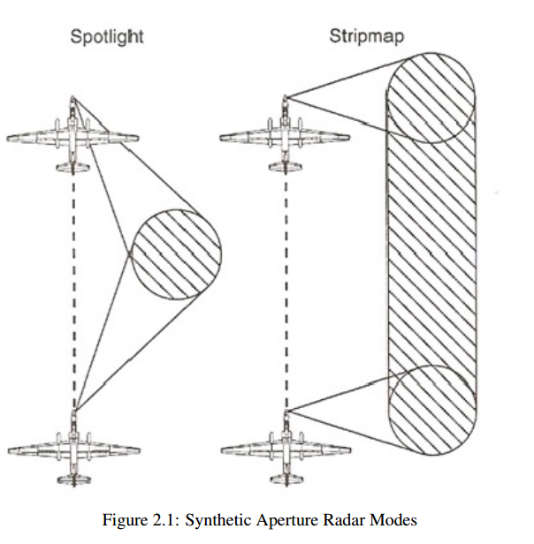
Sar image
SAR-mode “Stripmap”
The conventional SAR strip mapping mode assumes a fixed pointing direction of the radar antenna broadside to the platform track. A strip map is an image formed in width by the swath of the SAR and follows the length contour of the flight line of the platform itself. A detailed description of this mode you'll find on the topic SLAR.

Slide 29
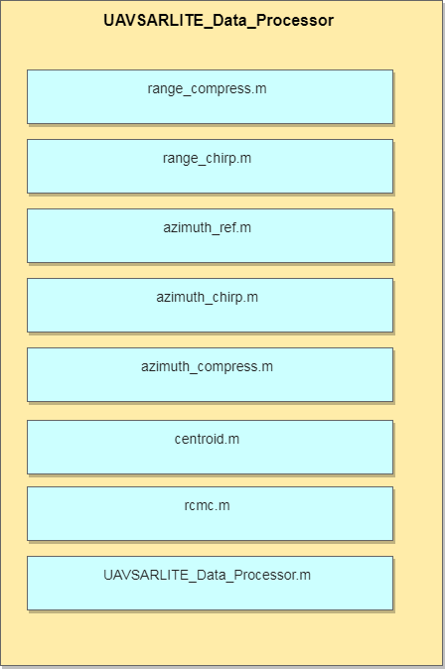
Uavsarlite_Data_processor

Slide 30
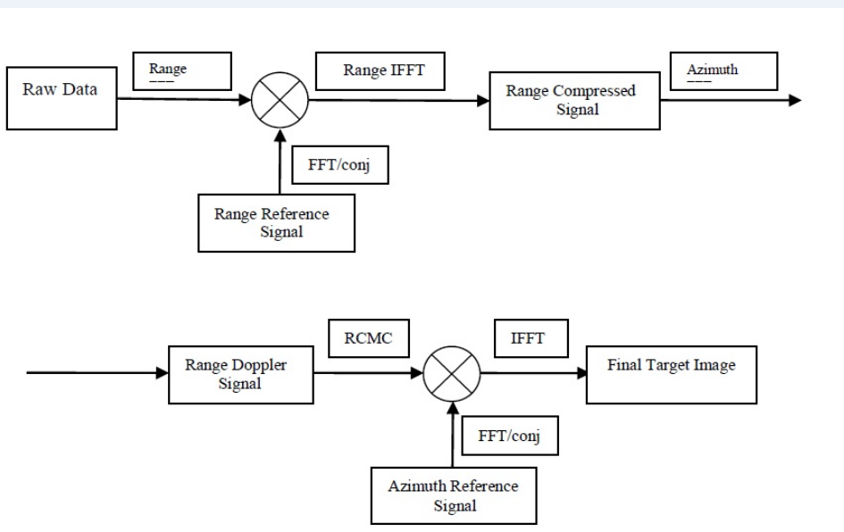
Uavsarlite_data_processor

Slide 31
Radar Software Test cases
UAVSARLITE_Data_Processor
Verify linear FM chirp signal
Verify range compressed signal
Verify Doppler centroid frequency
Verify Range Cell Migration Correction interpolator
Verify Azimuth reference signal
Verify Azimuth compressed signal
Verify Single Look Complex image for target

Slide 32
Radar Simulation in Matlab EXAMPLES
Build Radar Cube:
https://www.mathworks.com/company/newsletters/articles/building-and-processing-a-radar-data-cube.html
Phased Array System Toolbox:
https://www.mathworks.com/help/phased/index.html?s_tid=CRUX_lftnav
FMCW Antenna Sim:
https://www.mathworks.com/help/phased/examples/patch-antenna-array-for-fmcw-radar.html
Phased Array Design and Analysis:
https://www.mathworks.com/help/phased/phased-arrays.html?s_tid=CRUX_lftnav
Array Pattern Synthesis:
https://www.mathworks.com/help/phased/examples/array-pattern-synthesis.html

Slide 33
RADAR resources
SAR Training by NASA
https://www.asf.alaska.edu/data-tools/sar-training-processor/
Matlab
https://www.mathworks.com/help/supportpkg/android/index.html?s_tid=CRUX_lftnav
https://www.mathworks.com/help/pdf_doc/supportpkg/android/index.html
https://www.radartutorial.eu/01.basics/!rb02.en.html
https://ocw.mit.edu/resources/res-ll-003-build-a-small-radar-system-capable-of-sensing-range-doppler-and-synthetic-aperture-radar-imaging-january-iap-2011/projects/

Slide 34
Radar resources continued
Google drive
http://dev.ti.com/tirex/explore/node?node=ANHO2DdQ523mY5JJ5JzDdg__VLyFKFf__LATEST
http://dev.ti.com/tirex/explore/node?node=AJcVbr8AiXNoaBv.wihv2w__VLyFKFf__LATEST
http://dev.ti.com/tirex/explore/node?node=ANyYfhPgBXNj1C.iwjUscA__coGQ502__LATEST
Introduction to Airborne Radar by George W. Stimson
Digital Processing of Synthetic Aperture Radar Data by Ian Cummings and Frank Wong
http://dev.ti.com/tirex/explore/node?node=ANyYfhPgBXNj1C.iwjUscA__coGQ502__LATEST

